Slide 1
Case Study
Implementing IaaS and PaaS in Azure
- Muthamizhselvan Sarangabani

Slide 2
Contents
Business Requirements
Implementation flow
Takeaway Learnings

Slide 3

Business Requirements
Nilavembu Herbs provides a safer alternative to modern medicine wherever possible and to offer simple, effective and safe remedies for common problems. spreads awareness about the medicinal uses of these natural and safe herbs all over the world and to make it easily available through their online store for all those who want to enjoy its benefits
Nilavembu Herbs requires
A low cost solution based on demand of dynamic business conditions.
As the business expands across EastUS and SEA, they would like to have their DataCenter virtualised using cloud computing.
Critical Data should be made available in case of disaster
As of now they want to have Proof Of Concept(POC) in Microsoft Azure
You have been deployed for POC
The following slides will provides required details.

Slide 4
SEA region
2 web servers with 99.95% high availability
These web services has to be utilised with proper balance with client affinity with Public IP
Selected web servers should be reachable via RDP from internet
A jump port should accessible from internet to upload contents to web servers.
Protect web server traffic restricted to allowed based on ip addresses which will be updated as warranted
Enable backup for WebServers
Have alert generated in case of 80% above cpu usage

Slide 5
EastUS
EastUS server (Server11) should be accessible from internet via public IP
Establish secure Connection to SEA-EUS Azure sites
All servers should be reachable with internal ip addresses

Slide 6
Storage Requirements
EUS based resources should provide data resiliency in case of azure datacentre failure.
The storage should be accessible by applications with secure access. provide access urls and keys.
Sales manager should access his resource from windows explorer.
SEA data resources must provide high resiliency in case of even multiple azure data center failures

Slide 7
Azure Resource management
Create Vmadmin user who can manage all VM in the subscription
Create Backup_admin user who can manage backup only in EUS servers in EURG

Slide 8
Implementation Order
Resource Group – One for each region
vNet – Individual vnet per region with required Subnets
NSG – Different NSGs with required rules to allow inbound traffics to web servers, jump server & server11
Availability Set – one availability set for web servers with 2 Fault as well as Update Domains
VMs – Web servers & Jump servers in Southeast Asia and 1 server on East US
LB – One public internet facing loadbalancer with BE/HB/LBR/Inbound NAT and Client IP session persistence
vNet peering – Global vnet peering to make compute resources available in both regions
Storage Accounts – RA-GRS for Southeast Asia and ZRS for East US and requires SAS provisioning for sales manager access to file shares
VMs backup – Web servers VMs backup with required backup policy on RSV
Monitoring & Alert – Trigger alert when the web servers CPU utilization > 80%
RBAC – VMAdmin & BackupAdmin users creation with subscription level and RG level access respectively

Slide 9
Implementation Details
Using Terraform:
Resources | Southeast Asia Region | East US Region
Resource Group | searg | eusrg
Vnet | vnet1 (10.1.0.0/16) | vnet2 (10.2.0.0/16)
Subnet | websubnet (10.1.1.0/24) jumpsubnet (10.1.2.0/24) | eussubnet (10.2.1.0/24)
Vnet Peering | sea-to-eus | eus-to-sea
Availabilty Set | sea-aset | -
Network Security Group | nsg1 (NIC level) nsg2 (NIC level) | nsg (NIC level)
Windows VM | webvm-0 webvm-1 jumpvm-0 | Server11
Load Balancer (Public) | sealoadbalancer | -
Frontend IP configuration | lb_frontend (168.63.237.241) | -
Load balancing rules | LBRule | -
Backend pools | BackEndAddressPool (webvm) | -
Health probes | http-running-probe | -
Inbound NAT rules | RDPAccess | -
Storage Account | nvhseastg (RA-GRS) | nvheaststg (ZRS)

Slide 10
Implementation Details - cont
Using PowerShell:
Resources/Task | Southeast Asia Region | East US Region
Azure Backup | webrsv | -
Monitoring | CPU > 80%
RBAC
VM Contributor | vmadmin ( Subscription level) | -
Backup Contributor | - | bkadmin (RG level)
Using Ansible:
Install IIS on Web servers and to push website contents

Slide 11
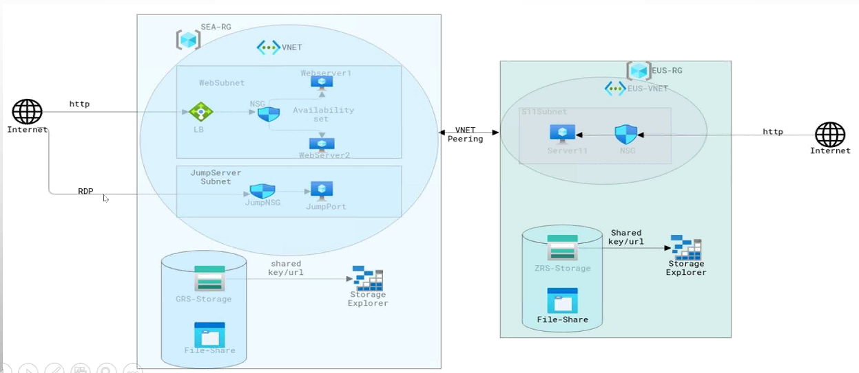
Architecture Diagram

Slide 12
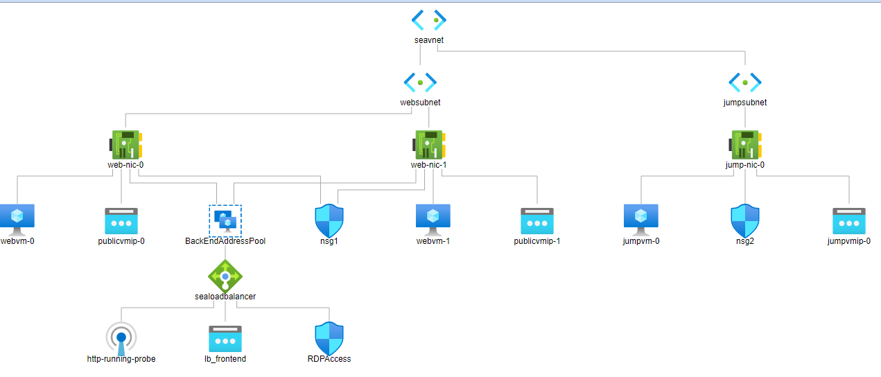
Southeast Asia Azure Resources Diagram

Slide 13
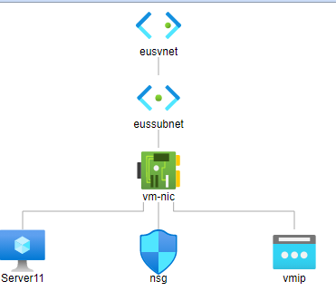
East US Azure Resources Diagram

Slide 14
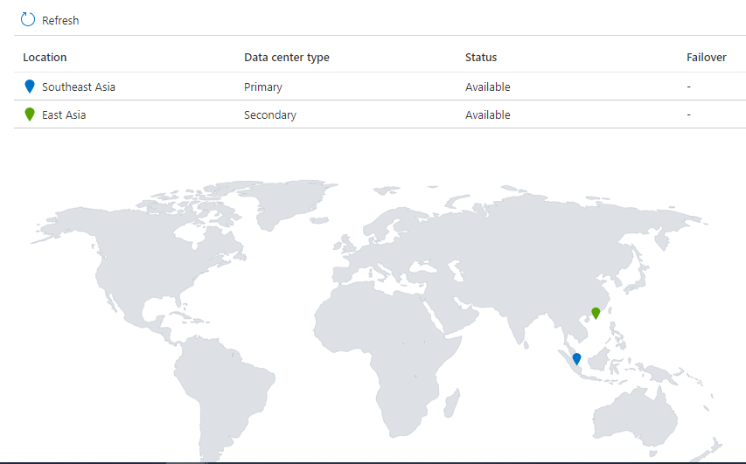
Storage Account - SEA

Slide 15
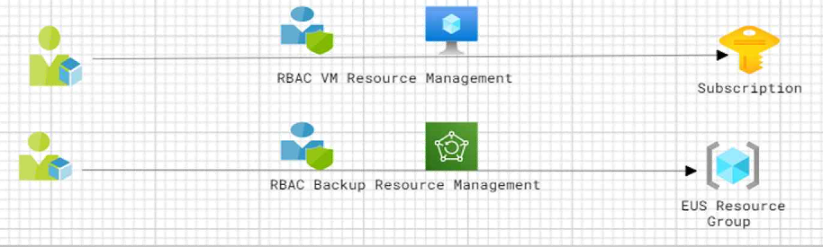
RBAC

